Slide 1
Optimizing workforce according to changing business needs
Course: PEOPLE-ANALYTICS-IT-8201-SU-2024-OE-Hutchison
Instructor: Professor Richard Hutchison
Term : EMBA Summer 2024
Made By : Ojesvi Dogra

Slide 2
Agenda
TCS is a global leader in IT services, consulting, and business solutions, delivering innovative and comprehensive technology services while employing the largest pool of talented individuals across the globe totaling up to a little over 600,000.
Even though TCS is amongst the best there are still some challenges within its workforce. In recent years, TCS has seen an inverse change within its workforce due to these emerging challenges.
These changes are dependent upon multiple factors, some of which we are going to discuss in this presentation.
Our objective today is to outline hypothetical steps to address these issues, focusing on solutions that would have a moderate to high impact on the organization while efficiently optimizing its workforce.

Slide 3
TCS Growth and challenges
In recent years, TCS has grown at purpose at an exponential rate while providing its consulting services and business solutions to clients around the globe.
With this exponential growth we have seen a rise in certain challenges that might affect the growth for the organization in longer period.
The challenges exist in various sectors of the workforce.
We will look into the recent growth of the organization to see the attrition rate, skills of the employee with the emerging trends and the empty positions within the organization.
Analyzing these factors will help us identify the inefficiencies within the organization.
The key players we will need for our analysis will be the organization stakeholders, HR organization and talent development organization.
The data we will need for our analysis will be the total employees within the organization, vacant positions in the organization and the skills expertise of our workforce.

Slide 4

What are the ProblemS?
Why is our attrition rate high? What are the factors affecting it, and how should we resolve it?
Why are there entry level vacant positions in the organization? Is the hiring criteria too high? How do we hire talented individuals?
Is our workforce experienced to work on emerging technologies?

Slide 5
TCS
Attrition Rate
In the recent year, we have seen a high attrition rate at TCS when compared to the industry average.
We will perform some analysis on the trends observed and employees feedback to find the factors driving the attrition rate.
Performing these analysis will give us an insight on the parameters that need improvement to control the attrition rate and bring it down

Slide 6
Factors impacting attrition rate
Through a sentiment analysis of employees feedback and trend analysis of our past data, we have been able to identify the following in the following:
  Lack of career progression seen by employees.
  Inadequate compensation observed by employees when compared to competitors.
  Significant spikes observed after yearly appraisal process highlights employee dissatisfaction.

Slide 7
Effective & efficient Hiring
Recently we have seen an active rise in vacant positions within our organization.
We will analyze the data related to these positions and the feedback from HR teams.
The analysis will help us identify the parameters that might need to be modified in our hiring criteria.

Slide 8
Factors for vacant positions
Through our trend analysis and Interviewer feed back we have been able to observe a significant gap in the skills for the recent interviewees.
As the skills required by our clients our growing with the emerging technology the various applicants have not been able to enhance their skills to certain level.
As the technology advances further, we see a train of this kill gap widening in future with the applicants.
As the applicants does not have significant access to learn about the basics of these required skills and hence will not be able to improve their portfolios for an organization requiring these advanced skills.

Slide 9
Enhancing Workforce skills
Through our cyclic communication with our clients we have observed a rise in negative feedback related to our workforce.
Most of the assessed feedback highlights a skill gap to client’s demands.
We will assess the feedback and internal digital learning modules provided to the employees.

Slide 10
Lacking skills of workforce
With the advancement of technologies are clients requirements are changing at oh fast pace than expected.
The skills expertise of our workforce has been lacking in some sectors according to the trend analysis of our client’s feed back.
Most of our workforce has a basic level of skill in these emerging technologies, but not advanced enough, fulfill our clients demand.
The level of skills loan learned by the workforce within the organizations, learning platforms, highlight that only the necessary certifications were achieved.
This trend highlights that workforce does not see any opportunities related to these technologies.

Slide 11
Necessary key points
Through our analysis we have been able to identify the sectors that need needs the stakeholders, attention, and effect these challenges have an organization goals.
High attrition rate leading to losing skilled employees while increasing training and hiring costs.
Skill gap between applicants and clients demand, leading to high vacant positions within workforce risking potential opportunities.
Lacking skill expertise within workforce creating a negative impact with client relationship.

Slide 12
Recommendations for stakeholders
Creating social networks informing employees about emerging opportunities within organization.
Revising compensation parameters to be more attractive than our competitors.
Revise performance appraisal process for more transparency.
Revising career development programs and introducing continuous learning opportunities for skills in demand by our clients.
Working with institutions to upscale the skills of potential applicants through events such as hackathons, learning bootcamps.

Slide 13
Implementation steps
Establish a 6 months cyclic timeline with clear milestones and feedback assessment.
HR team will have to work with reputable institutions to arrange events to share knowledge related to emerging trends.
Assign clear and conscise responsibilities to the department heads and managers to oversee the effective insight implementation ensuring accountability and coordination.
Initiating engaging pilot programs for career development and upscaling of emerging skills in departments while gathering feedback to refine strategies before a company- wide change.
Hosting events within workforce to educate the necessity of emerging trends and providing incentives for upscaling the expertise of the skills desired by clients.
Implementing a revised regular monitoring and evaluations process such as quarterly service performance metrics to track the progress and effectiveness of each initiative allowing for timely adjustments for efficient rollout.
Implementing a quarterly discussion with all the stake holders to discuss the effectiveness of the actions while sharing the data gathered from the workforce.

Slide 14
Results
A decrease in attrition rate was observed with the recent changes as it dropped to compared to previously.
A change was observed by the talent observation team as a significant number of workforce applied to gain expertise in emerging technologies.
We observed a significant improvement in the quality of recent applicants through the efforts of hosting events .
The reduction in turnover, workforce quality improvement and revised HR methodologies have led to a significant cost savings due to decreased recruitments and trainings.

Slide 15
Thank you
Made By : Ojesvi Dogra
Term : EMBA Summer 2024
Course: PEOPLE-ANALYTICS-IT-8201-SU-2024-OE-Hutchison
Instructor: Professor Richard Hutchison

Slide 16
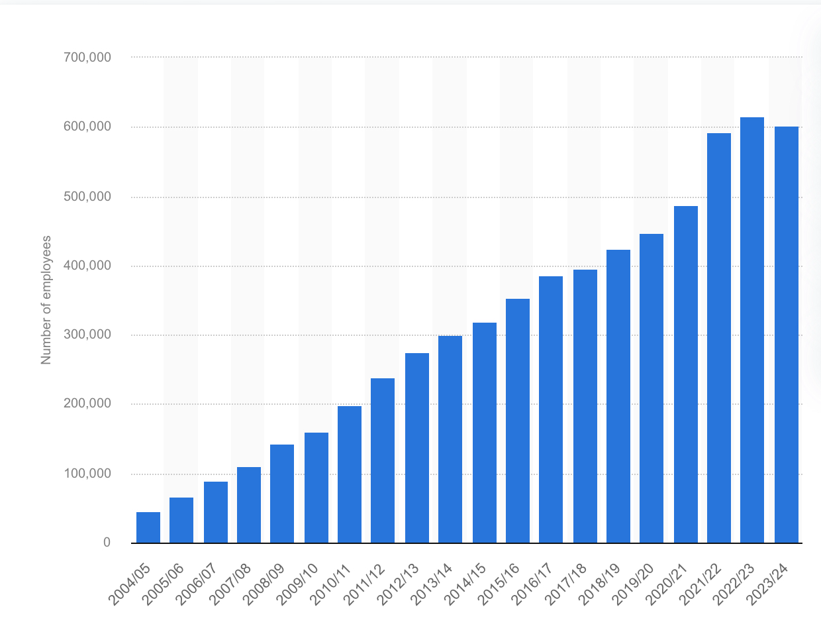
Appendix
This graph shows us the exponential growth of workforce at TCS. We can also see that in FY23 - FY24 there was a significant drop of employees which highlights the high attrition rate.

Slide 17
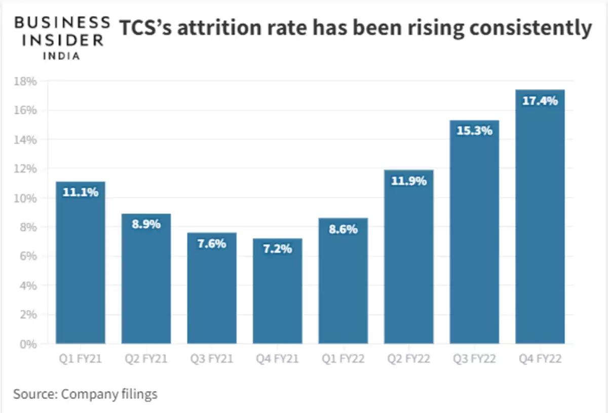
Appendix CONTD.
This graph represents the attrition rate clearly signifying it was existing prior as well.
Source: “ TCS CEO expects more employees to leave the firm in the coming months, but he is not worried about it — Here is why “, by Bhakti Makwana

Slide 18
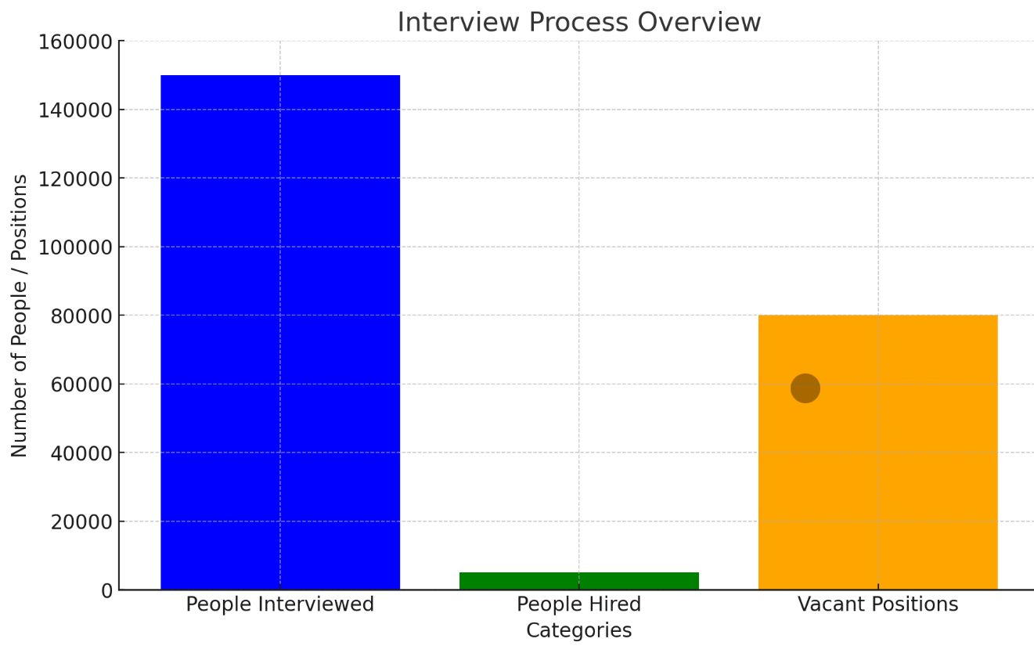
Appendix CONTD.
This graph represents the gap we have observed with the applicants and positions in our workforce.
We can see that only about 0.3% applicants were selected highlighting a skill gap of the applicants.

