Slide 1
Implementing AI-driven solution for workforce management
Course: MANAGERIAL-ECONOMICS-BUS-7500-FA-2024-WF-Jackson
Instructor: Professor Quentin Jackson
Term : EMBA Fall 2024
Made By : Ojesvi Dogra

Slide 2
Agenda
TCS is a global leader in IT services, consulting, and business solutions, delivering innovative and comprehensive technology services while employing the largest pool of talented individuals across the globe totaling up to a little over 600,000.
These changes are dependent upon multiple factors, some of which we are going to discuss in this presentation.
Our objective today is to outline hypothetical steps to address these issues, focusing on solutions that would have a moderate to high impact on the organization while efficiently optimizing its workforce operations.

Slide 3
TCS Growth and challenges
In recent years, TCS has grown at purpose at an exponential rate while providing its consulting services and business solutions to clients around the globe.
With this exponential growth we have seen a rise in certain challenges that might affect the growth for the organization in longer period.
The challenges exist in various sectors of the workforce.
We will look into the recent growth of the organization to see the attrition rate, skills of the employee with the emerging trends and the empty positions within the organization.
We will also discuss the Gen AI solutions for these challenges.

Slide 4

What are the ProblemS?
Why is our attrition rate high? What are the factors affecting it, and how should we resolve it?
Inefficient onboarding process. Relation of delayed onboarding process with productivity.

Slide 5
TCS high
Attrition Rate
In the recent year, we have seen a high attrition rate at TCS when compared to the industry average.
We will perform some analysis on the trends observed and employees feedback to find the factors driving the attrition rate.
High recruitment and training costs due to constant turnover.
Loss of experienced talent, leading to decreased operational efficiency.
Increased pressure on existing employees, resulting in lowered morale and productivity.

Slide 6
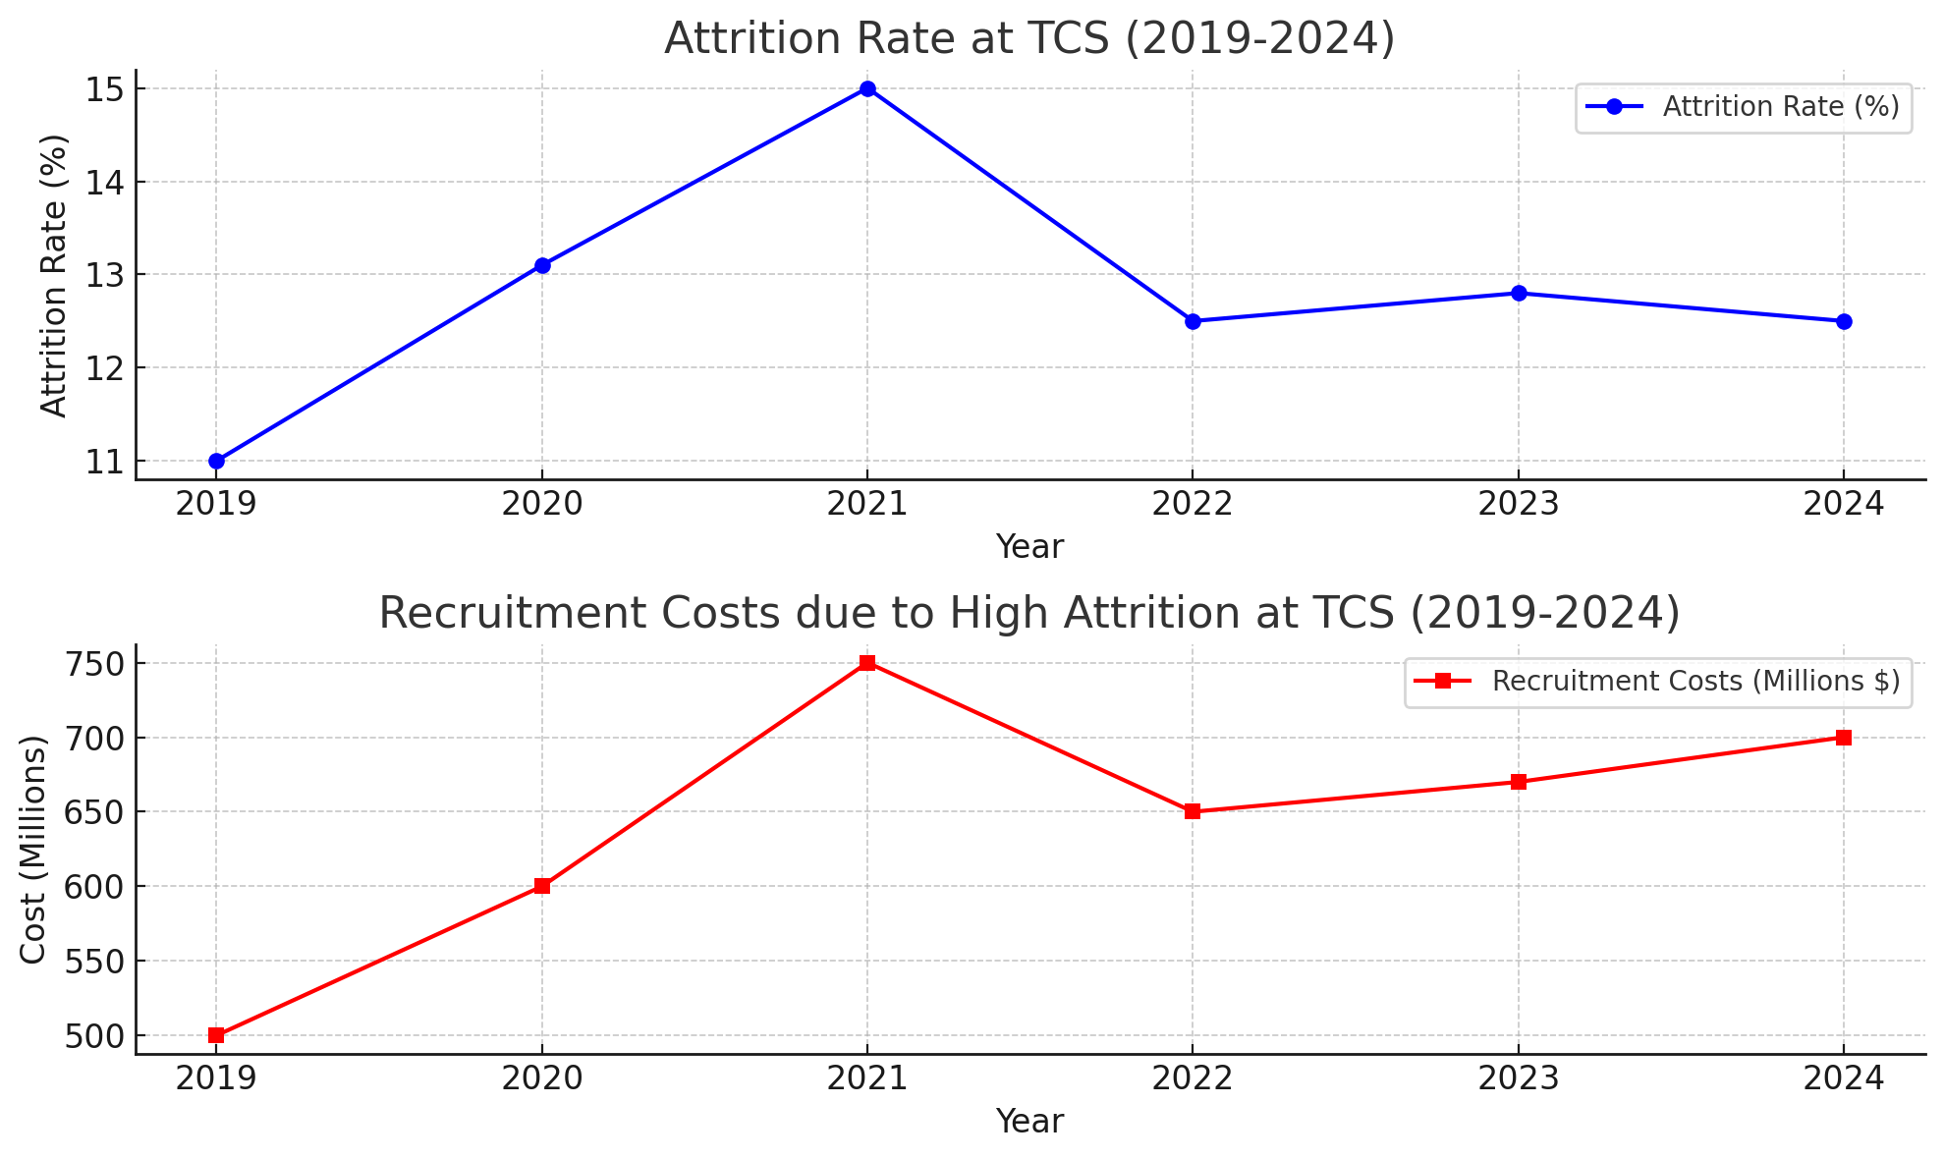
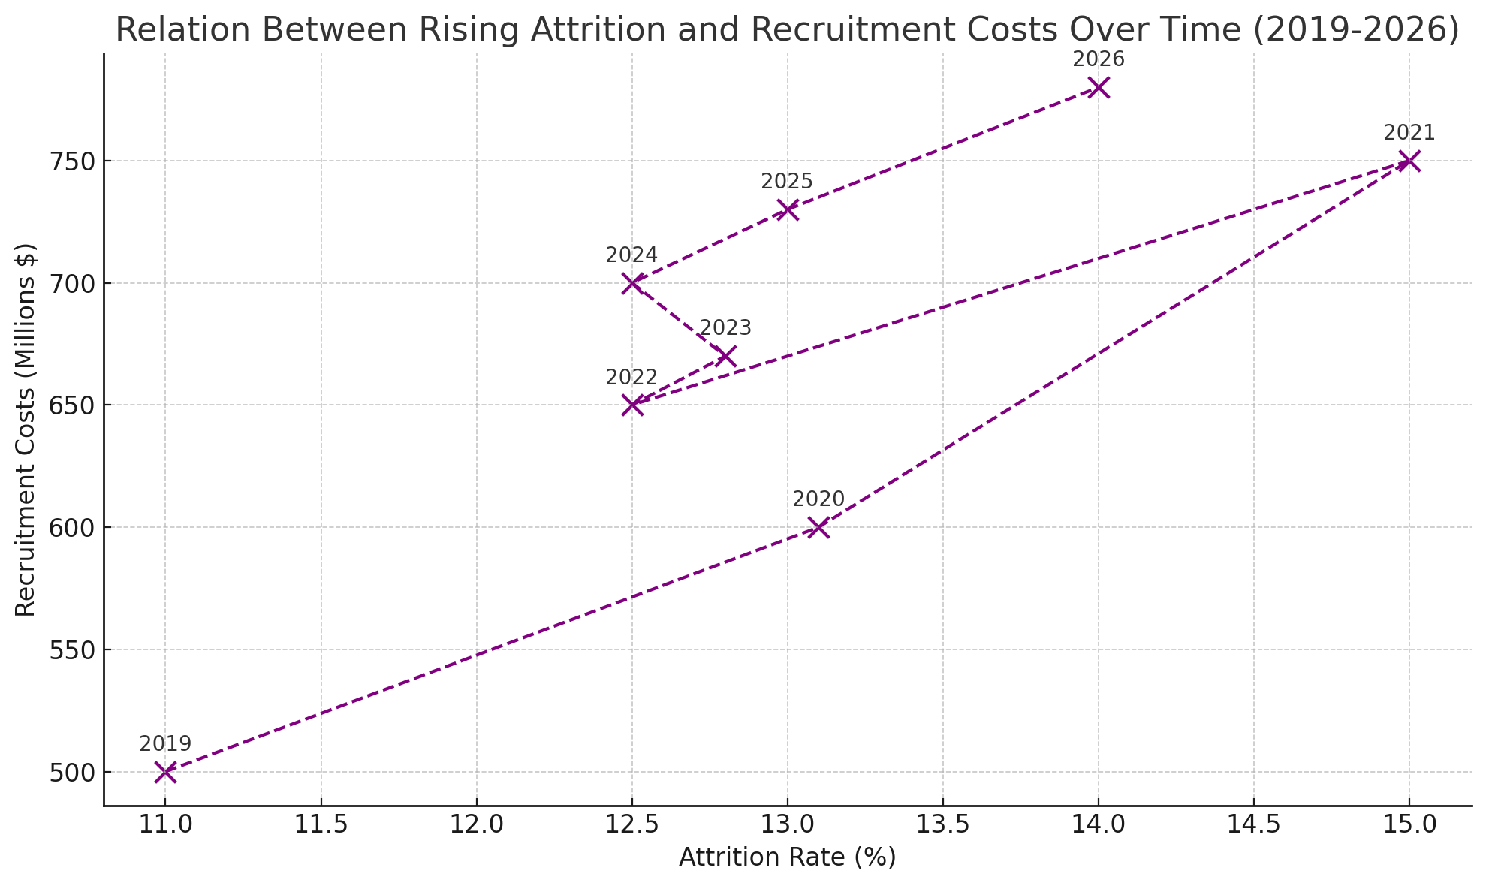
impact of High Attrition

Slide 7
Inefficient onboarding process
Recently we have seen an active rise in vacant positions within our organization.
Delayed productivity of new hires due to long learning curves.
Increased pressure on HR and training departments to provide continuous support.
Higher costs associated with extended onboarding periods.

Slide 8
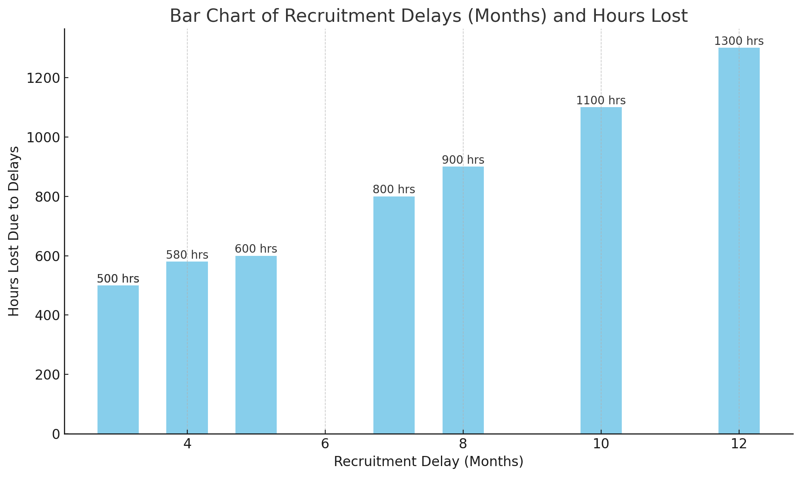
Impact of delayed onboarding
The graph here shows us the number of hours spent by the employees not working for the company or clients when their recruitment or the onboarding process is delayed by a certain period.

Slide 9
Implementing gen ai
FOR HIGH ATTRITION RATE
Personalized career development: Gen AI offers customized career growth paths for employees.
Real-time feedback: Employees receive immediate and relevant feedback to support their development.
Engaging work environments: Gen AI helps create more dynamic and engaging workplaces by providing tailored learning opportunities.
Internal growth opportunities: Gen AI assists employees in identifying and pursuing career advancements within the organization.
Continuous learning: Employees benefit from ongoing learning pathways to enhance their skills and job satisfaction.
Reduced turnover: By empowering and valuing employees, Gen AI helps lower attrition rates and improve retention.
FOR ONBOARDING PROCESS
Real-time access: Gen AI provides new employees with instant access to company resources, policies, and domain-specific knowledge.
Personalized assistance: Gen AI-driven assistants offer tailored summaries, such as vendor contracts and policies, to support specific job roles (e.g., procurement analysts).
Productivity from day one: With personalized information and guidance, new hires can become productive immediately.
Reduced onboarding timeline: Gen AI shortens the time it takes for employees to get up to speed.
Lower onboarding costs: The faster onboarding process reduces associated costs, benefiting the company's overall efficiency.

Slide 10
FUTURE STEPS
Periodic evaluations: Regular assessments of Gen AI implementation will help improve its effectiveness.
Tracking key metrics: Monitoring reduced onboarding time and attrition rates will allow for continuous improvements in Gen AI systems.
Positive outcomes: This approach will lead to a more engaged, satisfied, and productive workforce, reducing costs and improving operational efficiency.
Future improvements:
  Further integration of AI in performance appraisals.
  Continuous updates to AI models to adapt to changing workforce dynamics.
  Expansion of Gen AI’s role in talent management.

Slide 11
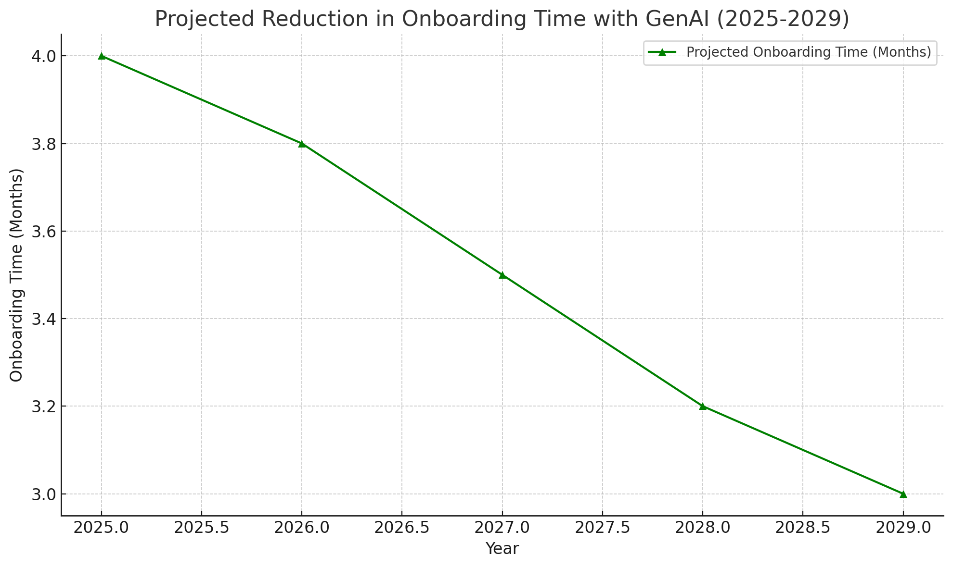
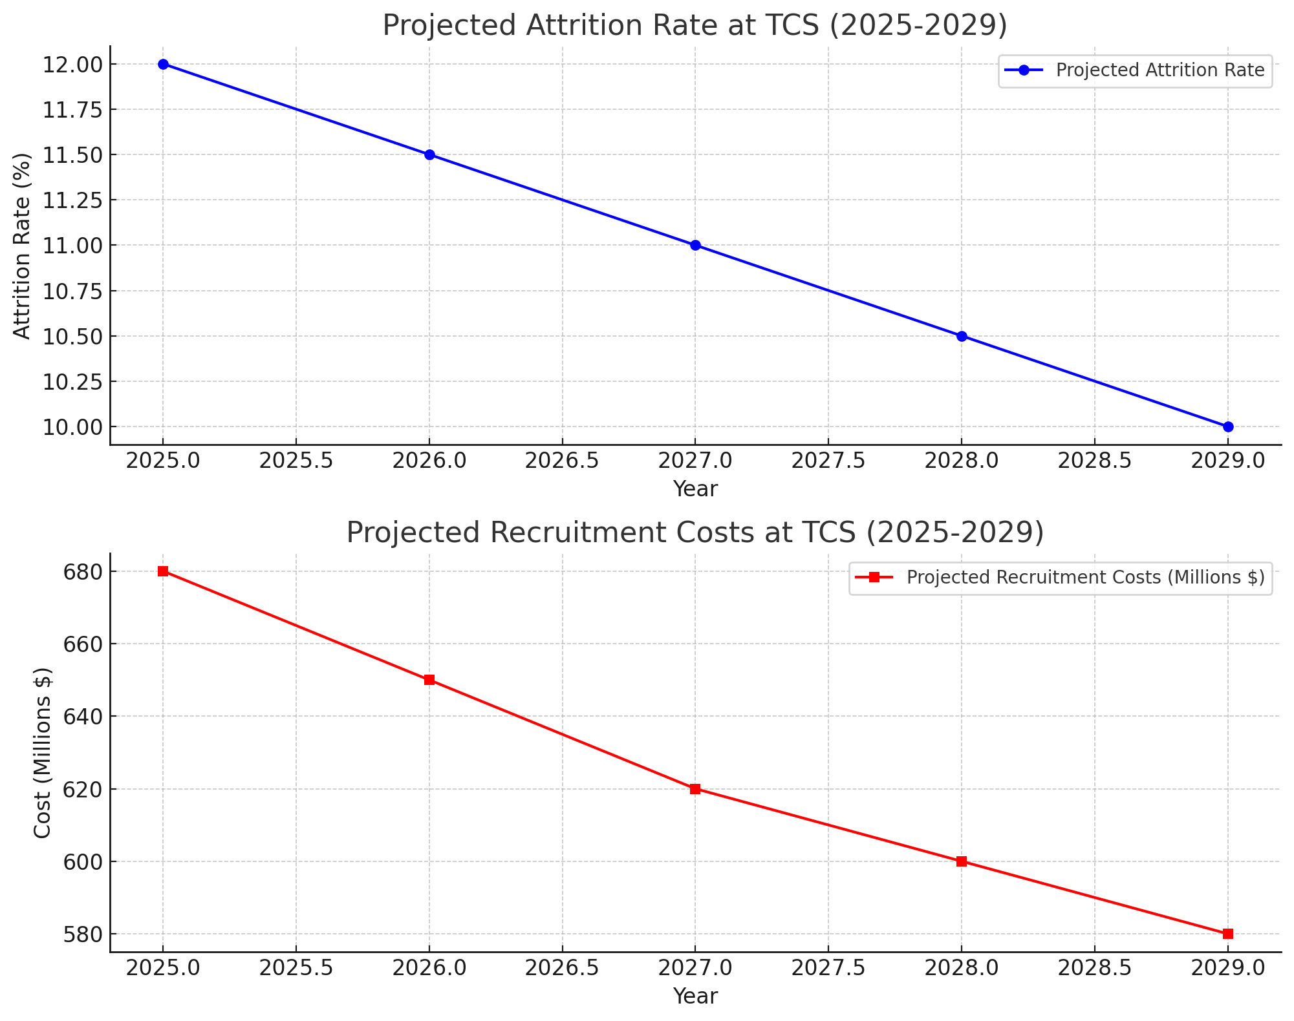
EXPECTED Results

Slide 12
Thank you
Made By : Ojesvi Dogra
Term : EMBA Summer 2024
Course: PEOPLE-ANALYTICS-IT-8201-SU-2024-OE-Hutchison
Instructor: Professor Richard Hutchison

